Slide 1
Introduction
ENGR 96A: Python and Machine Learning

Slide 2
Welcome to ENGR 96A Python and Machine Learning!

Slide 3
Course Instructors

Slide 4
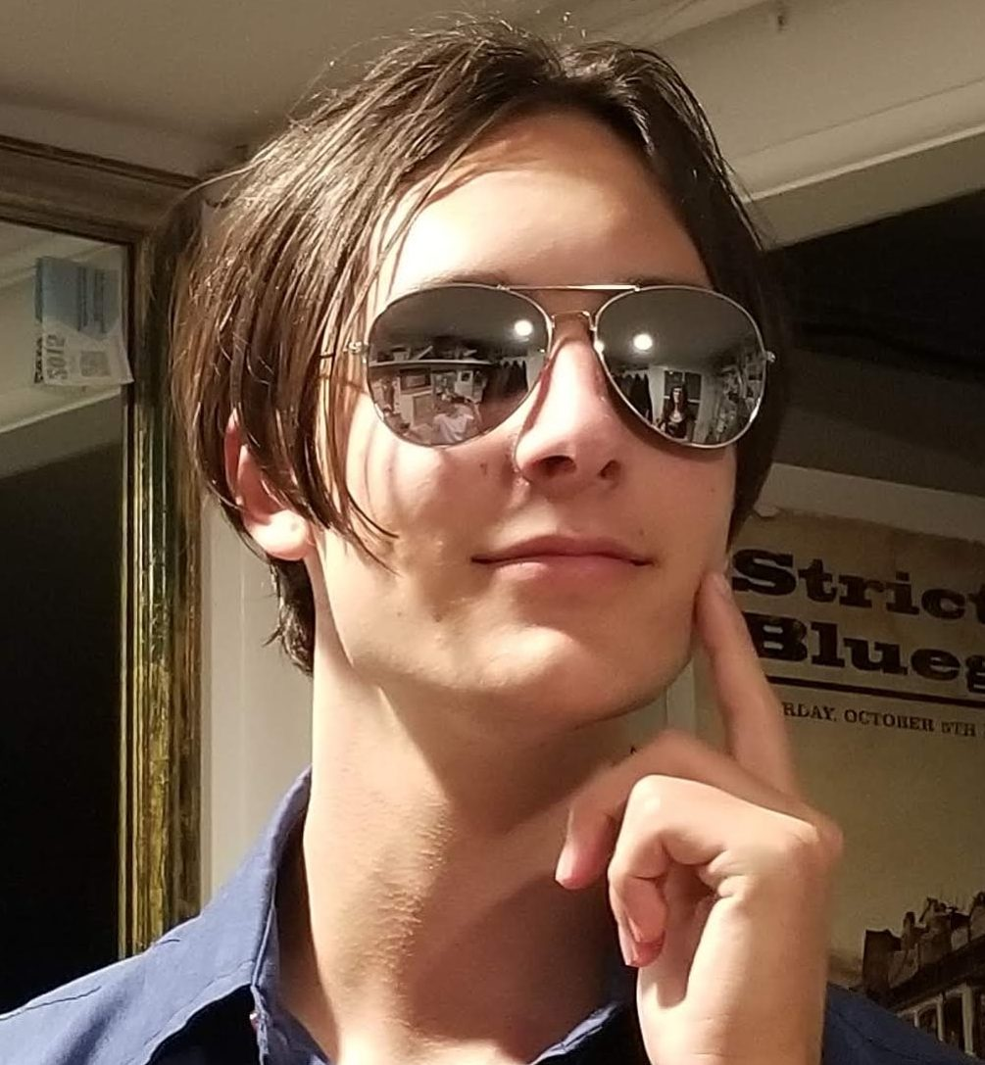
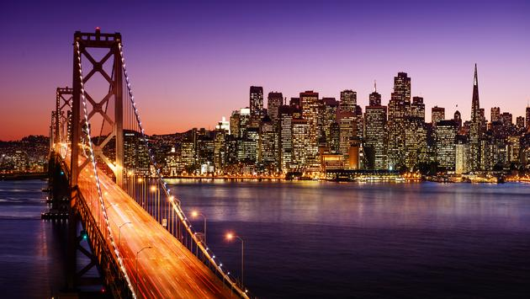
Ben Lanir
4th year computer engineering major
San Francisco
I enjoy board games and climbing
Machine learning classes
Machine learning in internship

Slide 5
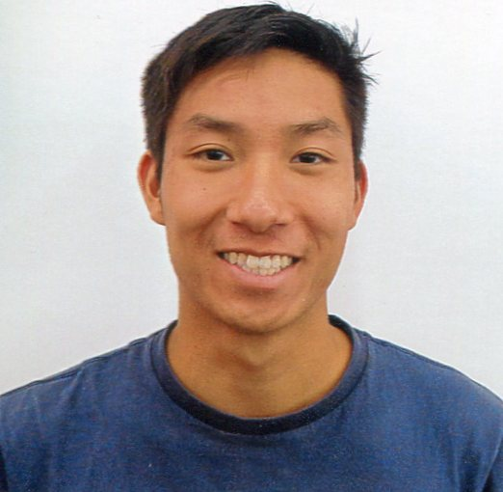
Dylan Lee
4th year computer science and engineering major
From San Diego
I’m a Canadian citizen

Slide 6
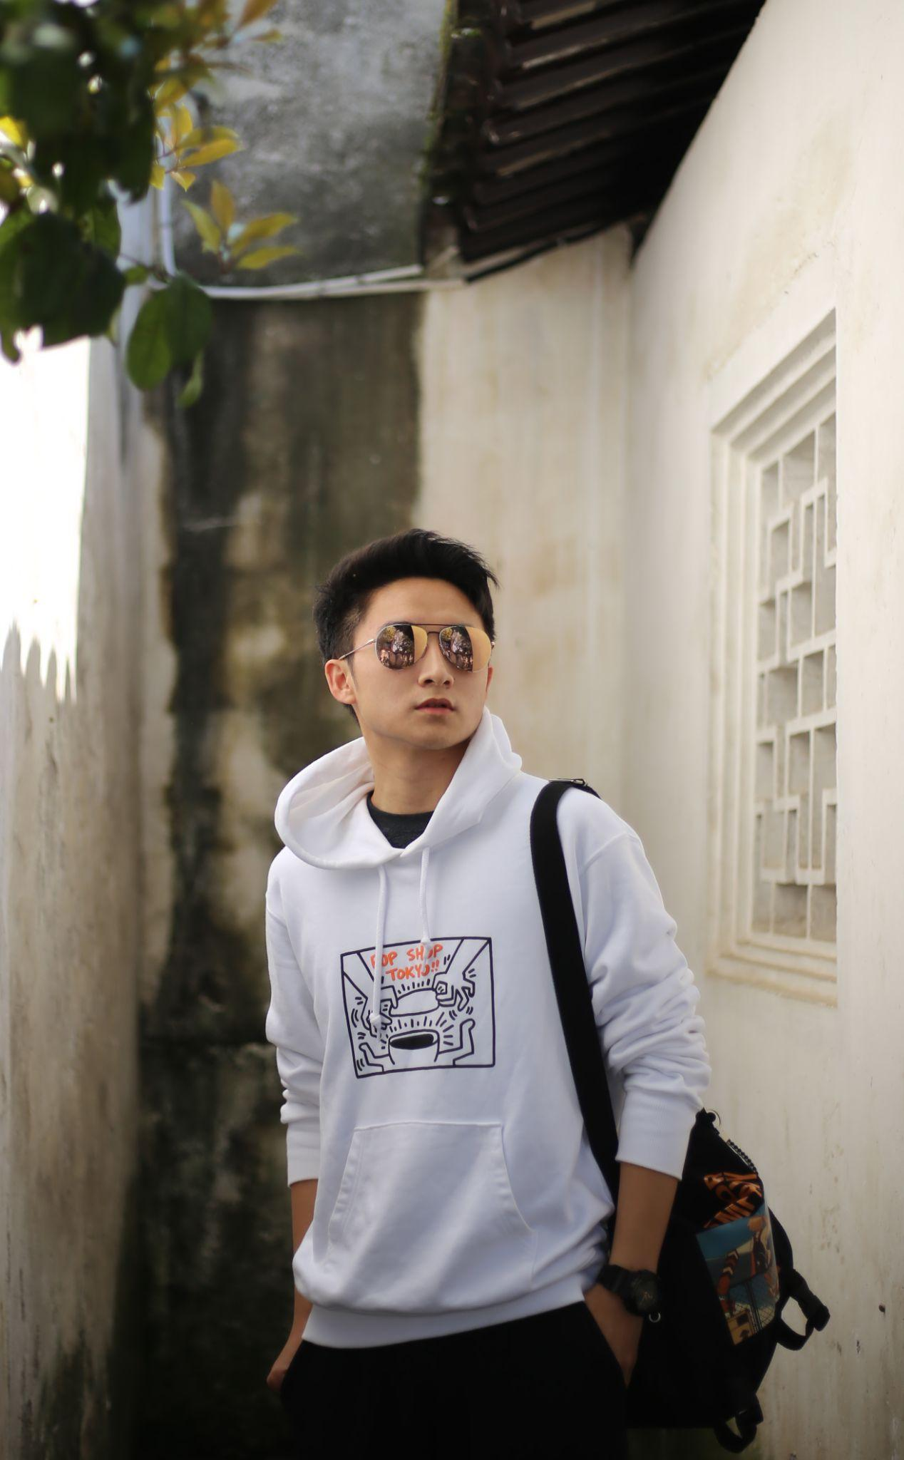

Bruce Qu
4th year Electrical Engineering Major
I am an international student from Beijing
I love photography and basketball
Cameras -> Photography -> Computer Vision -> PyTorch -> Machine Learning/AI

Slide 7
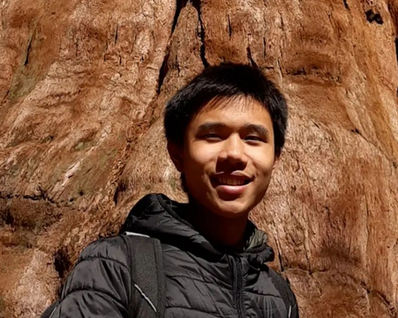

Enoch Huang
3rd year Electrical Engineering Major
From San Diego, CA
I am deaf in my right ear

Slide 8
Python and Machine Learning!
We created this class to give students exposure to both python and some common machine learning techniques early on in their undergraduate journey
No coding experience required, we will start from the ground up!

Slide 9


Course Outline
Week 1: Syllabus / Getting started with Pytho
Week 2: MLK Day
Week 3: Libraries I (Numpy + Matplotlib)
Week 4: Libraries II (Pandas + Sklearn) / Linear Regression
Week 5: Logistic Regression
Week 6: Neural Networks I
Week 7: Presidents’ Day
Week 8: Neural Networks II / Convolutional Neural Networks I
Week 9: Convolutional Neural Networks II
Week 10: Final project presentations

Slide 10
A side note…
If you are an expert in Machine Learning and Python, this class is not for you.
Recommendation: Enroll in Machine Learning classes in CS, ECE, STATS, MATH departments
If you are an expert in Machine Learning or Python, this class might seem very slow to you.

Slide 11
Logistics
Class will be held in Boelter 2808 (this room) every week
Except holidays
Class will be every Monday 9am-12pm
Lecture and lab will happen back-to-back, and will sometimes be interleaved with each other
Extra lab time will happen after completion of lectures

Slide 12
Expectations
Arrive to class on time and pay attention
If the class is too easy for you, we can adjust the complexity of assignments, just speak to an instructor!
If you have any questions for us, please speak up
Don’t worry about your grade! As long as you keep up with assignments, you will be okay
This is primarily a learning experience for all of you
This is the second time this class is being taught - if you have any comments for us please let us know!

Slide 13
Office hours
Dylan: Thursday 12-1pm, Engineering IV 67-127
Enoch: Mondays 12-1pm, Engineering IV 67-127
If these times don’t work for you reach out to us and we will try to accommodate you
Link to syllabus: https://bruinlearn.ucla.edu/courses/154870/assignments/syllabus

Slide 14
Introduce Yourself!
Name
Year
Major
Where you are from
Fun fact about yourself!

